Slide 1
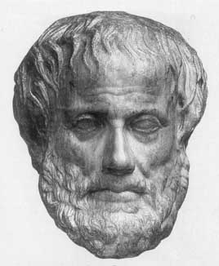
Lecture 2: AI Agents
Junfeng Yao
Slides used in the classroom only

Slide 2
Lecture overview
Artificial Intelligence
AI Agents

Slide 3
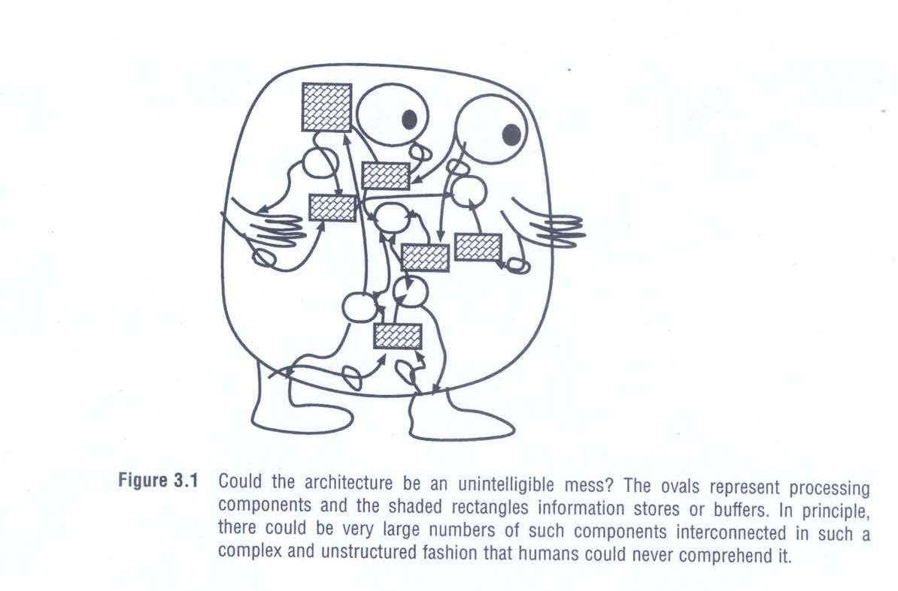
Could the architecture be an unintelligible mess?
Artificial Intelligence
1. AI Agents

Slide 4
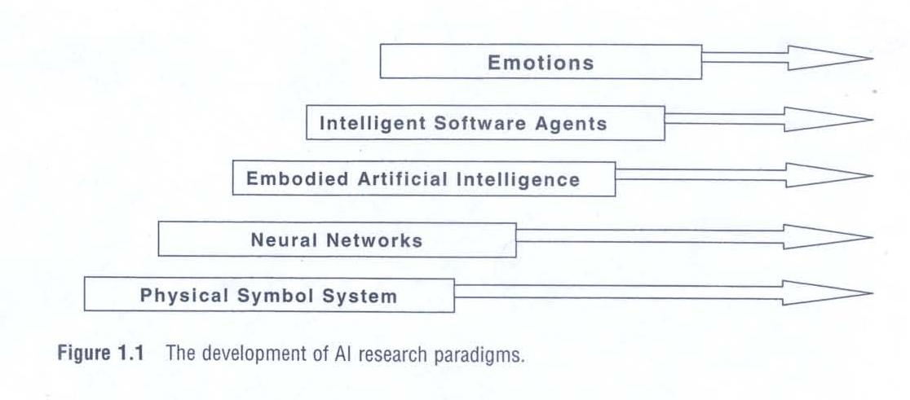
Development of AI research paradigms

Slide 5
Language and Considerations in AI
Language
  Notions and assumptions common to all AI projects
  (Slightly) philosophical way of looking at AI programs
  “Autonomous Rational Agents”,
    Following Russell and Norvig (textbook)
Considerations
  Extension to systems engineering considerations
  High level things we should worry about
    Before hacking away at code
  Internal concerns, external concerns, evaluation

Slide 6
Agents
Taking the approach by Russell and Norvig
  Chapter 2
An agent is anything that can be viewed as perceiving its
environment through sensors and acting upon the
environment through effectors
This definition includes:
  Robots, humans, programs

Slide 7
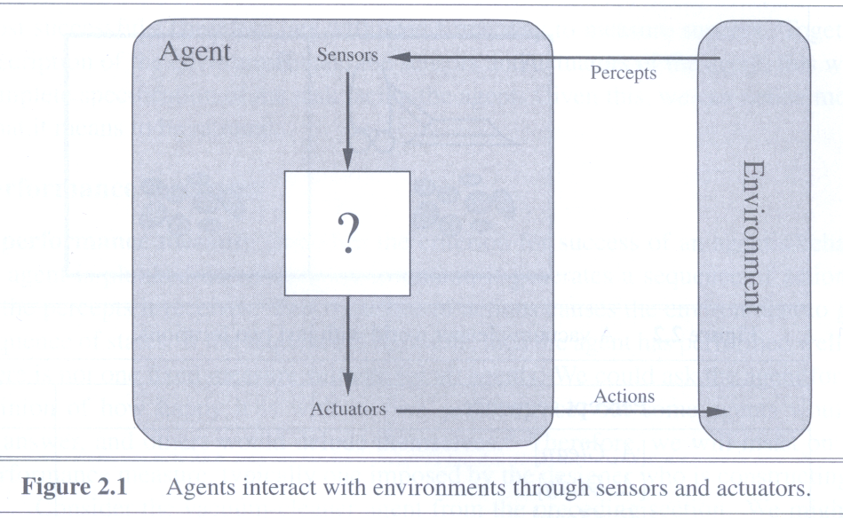
Agents
Figure 2.1

Slide 8
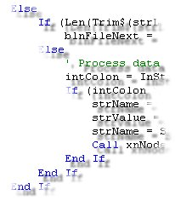

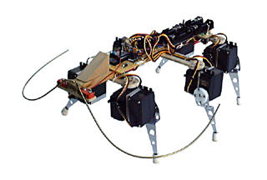
Examples of Agents
Humans Programs Robots
Senses, keyboard, mouse, dataset, cameras, pads,
body parts, monitor, speakers, files, motors, limbs

Slide 9
Rational Agents
A rational agent is one that does the right thing
Need to be able to assess agent’s performance
  Should be independent of internal measures
Ask yourself: has the agent acted rationally?
  Not just dependent on how well it does at a task
First consideration: evaluation of rationality

Slide 10
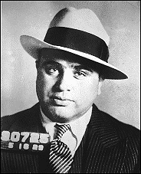
Thought Experiment:
Al Capone
Convicted for tax evasion
  Were the police acting rationally?
We must assess an agent’s rationality in terms of:
  Task it is meant to undertake (Convict guilty/remove crims)
  Experience from the world (Capone guilty, no evidence)
  It’s knowledge of the world (Cannot convict for murder)
  Actions available to it (Convict for tax, try for murder)
Possible to conclude
  Police were acting rationally (or were they?)

Slide 11
Performance measure
Performance measure for the how – the criteria that determine how successful an agent is.

Slide 12
Rationality and omniscience
An omniscient agent knows the actual outcome of its actions, and can act accordingly.
But, omniscience is impossible in reality.

Slide 13
Rational
What is rational depends on four things:
  The performance measure that defines degree of success.
  Everything that agent has perceived so far. (we call this complete perceptual history the percept sequence).
  What the agent knows about the environment.
  The action that the agent can perform.

Slide 14
Autonomy in Agents
The autonomy of an agent is the extent to which its
behaviour is determined by its own experience
Extremes
  No autonomy – ignores environment/data
  Complete autonomy – must act randomly/no program
Example – Baby learning to crawl
Ideal – design agents to have some autonomy
  Possibly good to become more autonomous in time

Slide 15
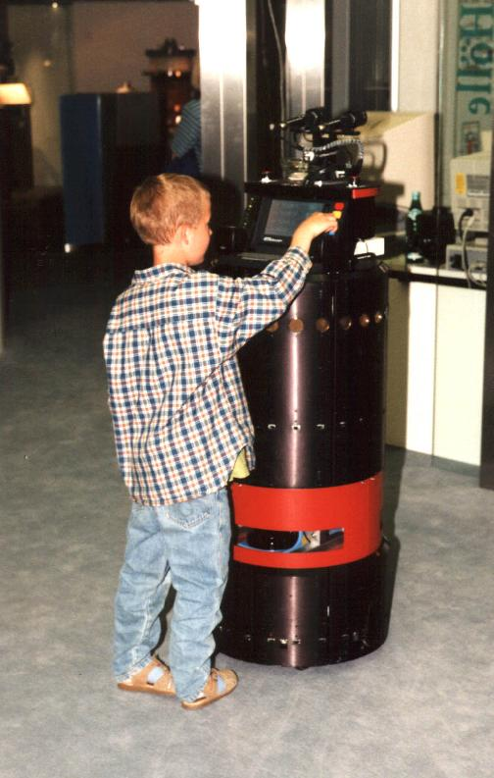
The RHINO Robot
Museum Tour Guide
Running Example
Museum guide in Bonn
Two tasks to perform
  Guided tour around exhibits
  Provide info on each exhibit
Very successful
  18.6 kilometres
  47 hours
  50% attendance increase
  1 tiny mistake (no injuries)

Slide 16
Internal Structure
Second lot of considerations
  Agent = Architecture + Program
    Architecture: some sort of computing device
  Knowledge of the Environment
  Reflexes
  Goals
  Utility Functions
The job of AI is to design the agent program: a function that implements the agent mapping from percepts to actions.

Slide 17
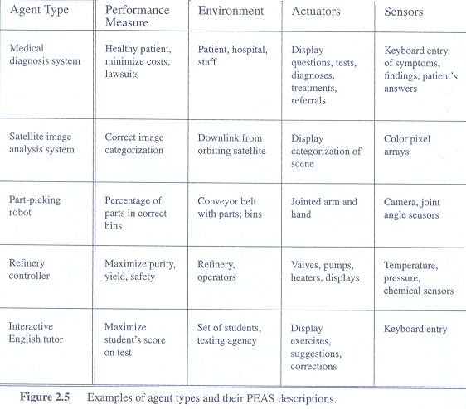
Examples of agent types
Figure 2.3

Slide 18
Architecture and Program
Program
  Method of turning environmental input into actions
Architecture
  Hardware/software(OS,etc.)
    Upon which the agent’s program runs
RHINO’s architecture:
  Sensors (infrared, sonar, tactile, laser)
  Processors (3 onboard, 3 more by wireless Ethernet)
RHINO’s program:
  Low level: probabilistic reasoning, visualisation,
  High level: problem solving, planning (first order logic)

Slide 19
The taxi driver agent type
What performance measure would we like?
  Get to the correct destination
  Minimize fuel consumption and wear and tear
  Minimize the trip time and cost
  Minimize violations of traffic laws and disturbances to other drivers
  Maximize safety and passenger comfort
  Maximize profits

Slide 20
Write the agent program: five types of agents
An agent based on a prespecified look up table (A simple agent)
Simple reflex agents
Agents that keep track of the world
Goal-based agents
Utility-based agents

Slide 21
A simple agent
Doomed to failure:
The table needed for something as simple as an agent that can only play chess would be about 35¹⁰⁰ entries.
It would take quite a long time for the designer to build the table.
The agent has no autonomy at all. If the environment changed in some unexpected way, the agent would be lost.

Slide 22
Knowledge of Environment
Knowledge of Environment (World)
  Different to sensory information from environment
World knowledge can be (pre)-programmed in
  Can also be updated/inferred by sensory information
Using knowledge to inform choice of actions:
  Use knowledge of current state of the world
  Use knowledge of previous states of the world
  Use knowledge of how its actions change the world
Example: Chess agent
  World knowledge is the board state (all the pieces)
  Sensory information is the opponents move
  It’s moves also change the board state

Slide 23
RHINO’s Environment Knowledge
Programmed knowledge
  Layout of the Museum
    Doors, exhibits, restricted areas
Sensed knowledge
  People and objects (chairs) moving
Affect of actions on the World
  Nothing moved by RHINO explicitly
  But, people followed it around (moving people)

Slide 24
Reflexes
Action on the world
  In response only to a sensor input
  Not in response to world knowledge
Humans – flinching, blinking
Chess – openings, endings
  Lookup table (not a good idea in general)
    35¹⁰⁰ entries required for the entire game
RHINO: no reflexes?
  Dangerous, because people get everywhere

Slide 25
A simple reflex agent
It works by finding a rule whose condition matches the current situation and then doing the action associated with that rule. (Figure 2.9)
It will work only if the correct decision can be made on the basis of the current percept.

Slide 26
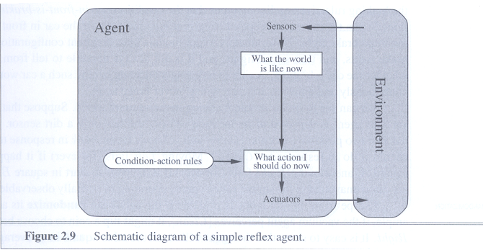
A simple reflex agent
Figure 2.7

Slide 27
Updating internal state information in simple reflex agents
Requires two kinds of knowledge:
We need some information about how the world evolves independently of the agent
We need some information about how the agent’s own actions affect the world

Slide 28
Goals
Always need to think hard about
  What the goal of an agent is
Does agent have internal knowledge about goal?
  Obviously not the goal itself, but some properties
Goal based agents
  Uses knowledge about a goal to guide its actions
  E.g., Search, planning
RHINO
  Goal: get from one exhibit to another
  Knowledge about the goal: whereabouts it is
  Need this to guide its actions (movements)

Slide 29
Goal-based agents
Knowing about the current state of the environment is not always enough to decide what to do. Why?
  To solve unseen problems, need rewrite a large number of condition-action rules.
A goal-based agent is far more flexible.
Figure 2.11 shows the goal-based agent’s structure.

Slide 30
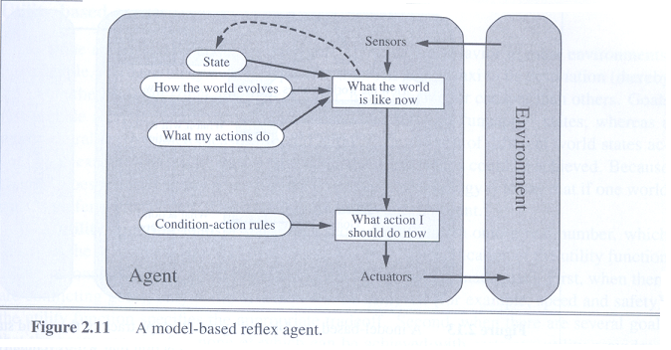
A model-based reflex agent

Slide 31
Utility Functions
Knowledge of a goal may be difficult to pin down
  For example, checkmate in chess
But some agents have localised measures
  Utility functions measure value of world states
  Choose action which best improves utility (rational!)
  In search, this is “Best First”
  Utility is a function that maps a state onto a real number, which describes the associated degree.
RHINO: various utilities to guide search for route
  Main one: distance from the target exhibit
  Density of people along path

Slide 32
Utility-based agents
Goals alone are not really enough to generate high-quality behaviour.
A complete specification of the utility function allows rational decisions in two kinds of cases where goals have trouble.
  When there are conflicting goals, only some of which can be achieved.
  When there are several goals that the agent can aim for, none of which can be achieved with certainty, utility provides a way in which the likelihood of success can be weighed up against the importance of the goals.

Slide 33
Details of the Environment
Must take into account:
  some qualities of the world
Imagine:
  A robot in the real world
  A software agent dealing with web data streaming in
Third lot of considerations:
  Accessibility, Determinism
  Episodes
  Dynamic/Static, Discrete/Continuous

Slide 34
Accessibility of Environment
Is everything an agent requires to choose its actions available to it via its sensors?
  If so, the environment is fully accessible
If not, parts of the environment are inaccessible
  Agent must make informed guesses about world
In RHINO, the authors talk about:
  “Invisible” objects which couldn’t be sensed
  Including glass cases and bars at particular heights
  Software adapted to take this into account

Slide 35
Determinism in the Environment
Does the change in world state
  Depend only on current state and agent’s action?
Non-deterministic environments
  Have aspects beyond the control of the agent
  Utility functions have to guess at changes in world
Robot in a maze: deterministic
  Whatever it does, the maze remains the same
RHINO: non-deterministic
  People moved chairs to block its path

Slide 36
Episodic Environments
Is the choice of current action
  Dependent on previous actions?
  If not, then the environment is episodic
In non-episodic environments:
  Agent has to plan ahead:
    Current choice will affect future actions
RHINO:
  Short term goal is episodic
    Getting to an exhibit does not depend on how it got to current one
  Long term goal is non-episodic
    Tour guide, so cannot return to an exhibit on a tour

Slide 37
Static or Dynamic Environments
Static environments don’t change
  While the agent is deliberating over what to do
Dynamic environments do change
  So agent should/could consult the world when choosing actions
  Alternatively: anticipate the change during deliberation
  Alternatively: make decision very fast
RHINO:
  Fast decision making (planning route)
  But people are very quick on their feet

Slide 38
Discrete or Continuous
Environments
Nature of sensor readings / choices of action
  Sweep through a range of values (continuous)
  Limited to a distinct, clearly defined set (discrete)
Maths in programs altered by type of data
Chess: discrete
RHINO: continuous
  Visual data can be considered continuous
  Choice of actions (directions) also continuous

Slide 39
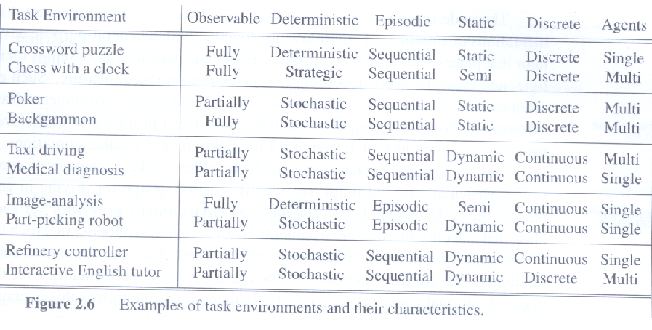
Examples of task environments
Figure 2.6

Slide 40
RHINO’s Solution to
Environmental Problems
Museum environment:
  Inaccessible, non-deterministic, dynamic, continuous
RHINO constantly update plan as it moves
  Solves these problems very well
  Necessary design given the environment

Slide 41
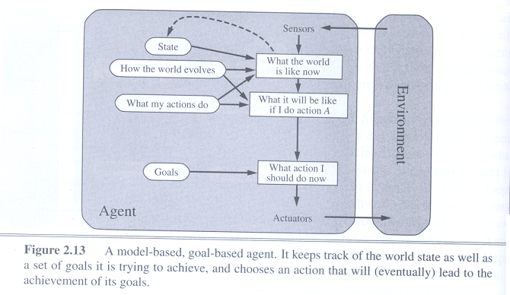
Examples of environments
Figure 2.13

Slide 42
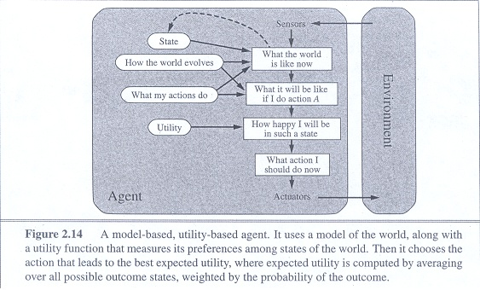
A model-based, utility-based agent

Slide 43
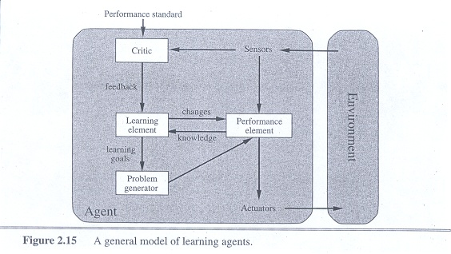
A general model of learning agent

Slide 44
Summary
Think about these in design of agents:
Internal structure
of agent
How to test
whether agent
is acting
rationally
Autonomous
Rational
Agent
Specifics about
the
environment
Usual systems
engineering stuff

Slide 45
Key terms
Agent
Autonomous
Agent program
Reflex agents, goal-based agents, utility-based agents
…
…

Slide 46


Questions & Suggestions?
The End

